Slide 1
www.MINEPORTAL.in
ONLINE TEST SERIES FOR
DGMS COAL/METAL FIRST/SECOND CLASS EXAM
GATE MINING EXAM
OVERMAN EXAM TEST
MINING INSPECTOR EXAMS
COAL INDIA MTs & OTHER PSUs EXAMS
FREE STUDY MATERIAL & VIDEO LECTURES
MINING JOBS NOTIFICATIONS
www.mineportal.in Call/Whatsapp-8804777500 www.fb.com/mineportal.in

Slide 2
BLOCK MODELING USING SURPAC

Slide 3
1. BLOCK MODELLING
The Block model is a form of spatially-referenced database that provides a means for modelling a 3-D body from point and interval data such as drill hole sample data. The Block model consists of interpolated values rather than true measurements. It provides a method of estimating volume, tonnage, and average grade of a 3-D body from sparse drill hole data.

Slide 4
2. SURPAC
SURPAC is a complete mine planning software which has various modules ranging from drilling and blasting, surveying, pit design, geo-statistics and grade control, block modeling, solid modeling, open pit design, underground design etc.
Its advantages are user friendliness, full customization as per customer’s needs and high flexibility.

Slide 5
3. Objective of Block Modeling using Surpac
familiarise with Surpac’s block modelling module and the concept of block modelling.
learn to fill a block model from drill hole data from a geological database.
learn to constrain a block model to filter out specific blocks.
learn to report volume, tonnage and grade from a block model.
learn about column processing of a block model.

Slide 6
4. Basic Overview of Steps Involved in Block Modeling
From the available exploration data, a geological database is created to determine the extent of ore deposit and characteristics.
The borehole data are composited in order to use it to find geo-statistical values of the deposit.
The boreholes are displayed on the basis of the collar values taking into account the coordinates.

Slide 7
Overview (continued)
Once the geological database is created, total volume of reserve can be estimated by developing solid model comprising of all these borehole data.
In order to obtain the solid model, the borehole present in the database are sectioned at regular interval and the strings are stitched together to form solid model.
The solid model so developed is then fitted into a block model of regular size developed to generate a constraint block model.

Slide 8
5. Block Modelling Concepts
Model Space
Blocks and Attributes
Constraints
Estimation

Slide 9
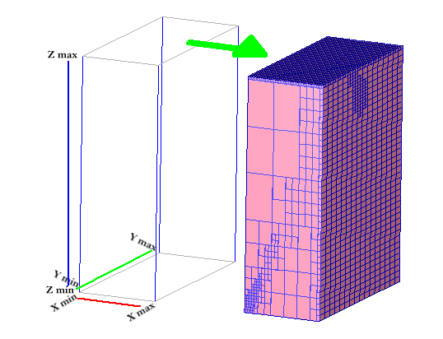
5.1 Model Space
3D coordinates spatially define the model extents. Minimum Northing (Y), Easting (X) and Elevation (Z). Maximum Northing (Y), Easting (X) and Elevation (Z).

Slide 10
5.2 Blocks and Attributes
The centroid of each block defines its’ geometric dimensions in each axis, i.e. its coordinates, Y, X, and Z. Each block contains attributes for each of the properties to be modelled. The properties or attributes may contain numeric or character string values. Blocks may be of varying size defined by the user once the block model is created.

Slide 11
5.3 Constraints
All Block model functions may be performed with constraints. A constraint is a logical combination of one or more spatial objects on selected blocks. Objects that may be used in constraints are plane surfaces, DTMs, solids, closed strings and block attribute values. Constraints may be saved to a file for rapid re-use and may themselves be used as components of other constraints.

Slide 12
5.4 Estimation
Once a Block model is created and all attributes defined, the model must be filled by some estimation method. This is achieved by estimating and assigning attribute values from sample data which has X Y Z coordinates and the attribute values of interest. Certain estimation methods:
Nearest Neighbour
Inverse Distance
Assign Value
Ordinary Kriging
Import Centroids

Slide 13
6. Pictures demonstrating the various elements in the Surpac software

Slide 14
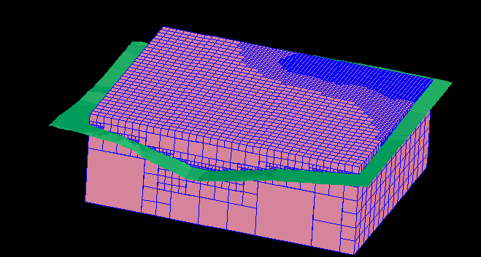
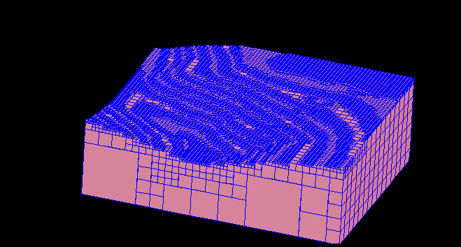
6.1 Block Models

Slide 15
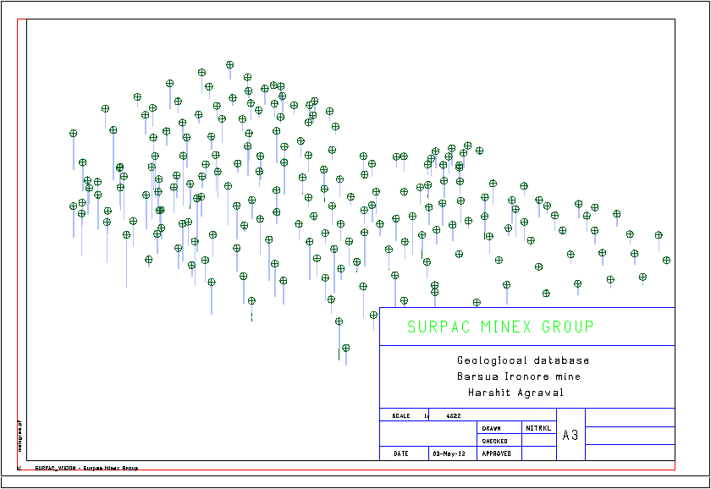
6.2 Borehole Data Display

Slide 16
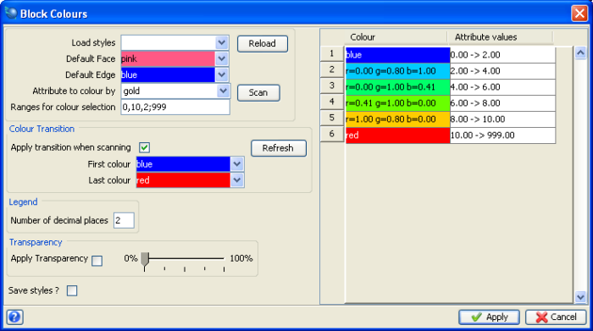
6.3 Random Surpac Window

Slide 17
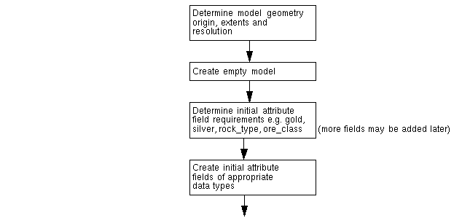
7. Workflow of Steps

Slide 18
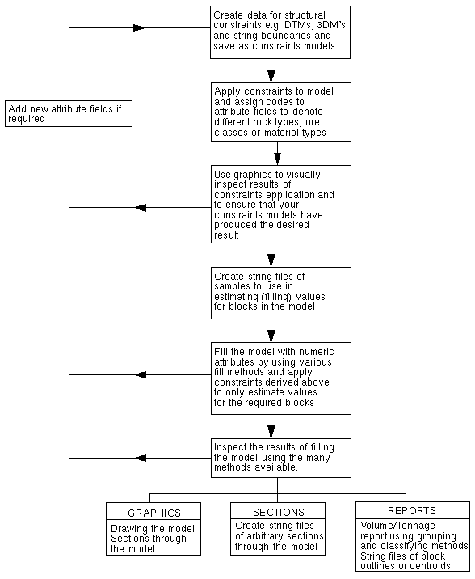

Slide 19
We take an example:
Now we are creating a block model

Slide 20
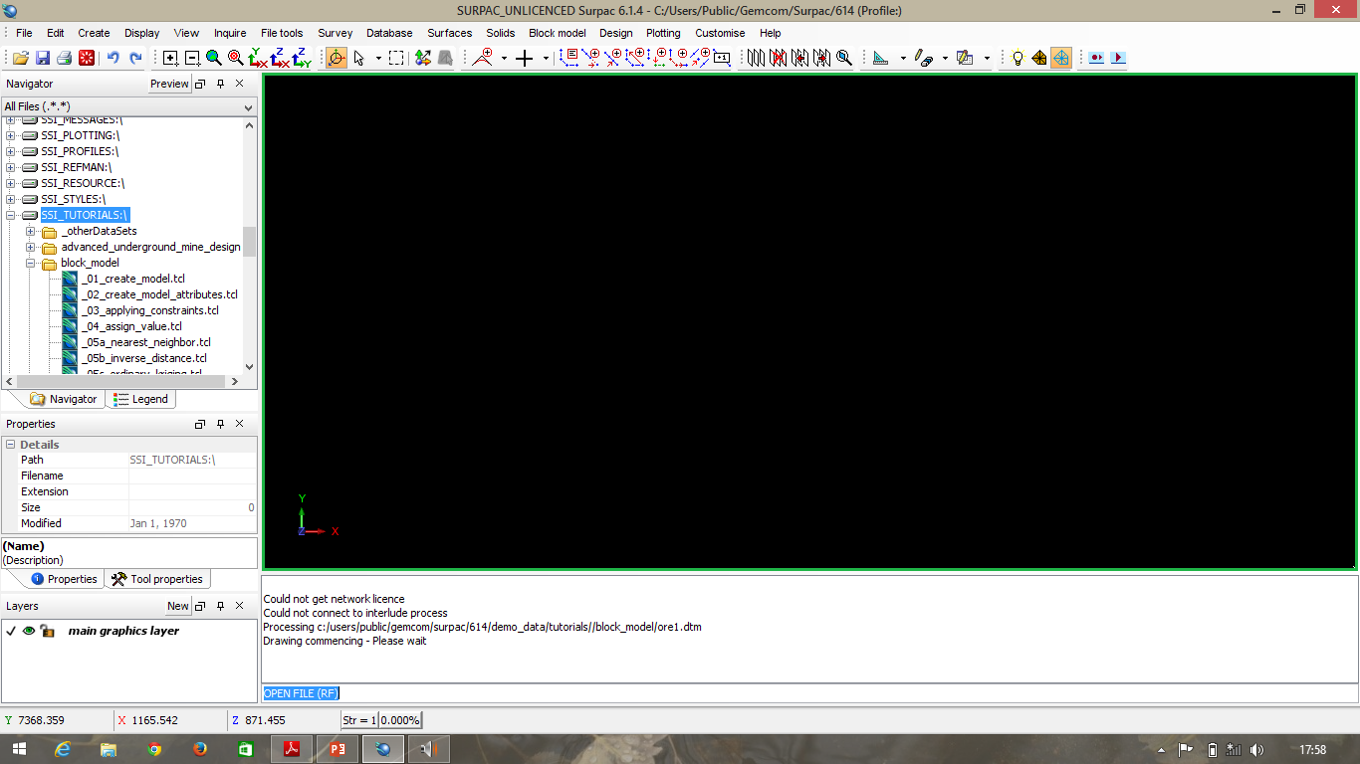
In the “Navigator” on the left hand side bar of Surpac select “SSI_TUTORIALS:\”

Slide 21
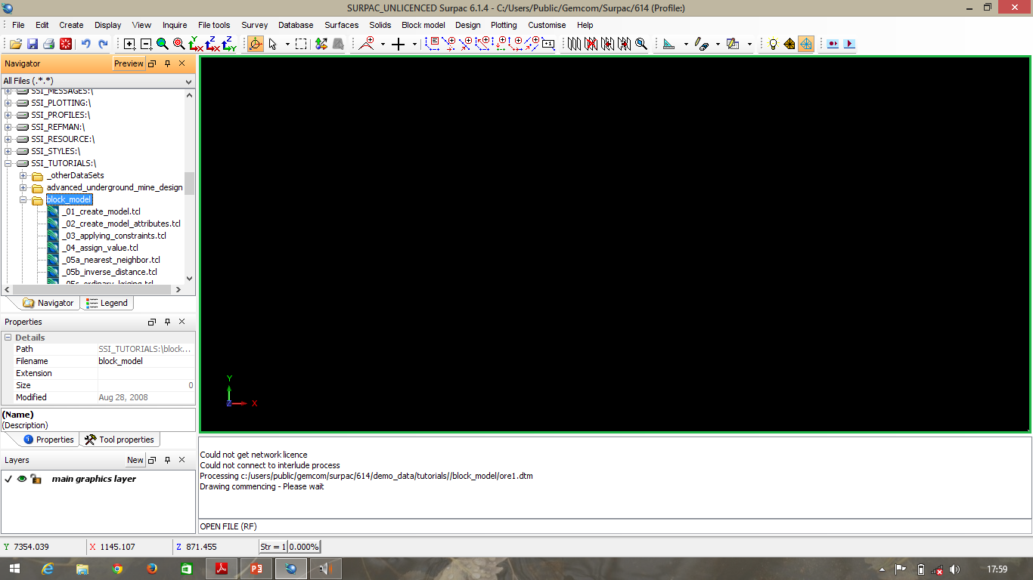

Slide 22
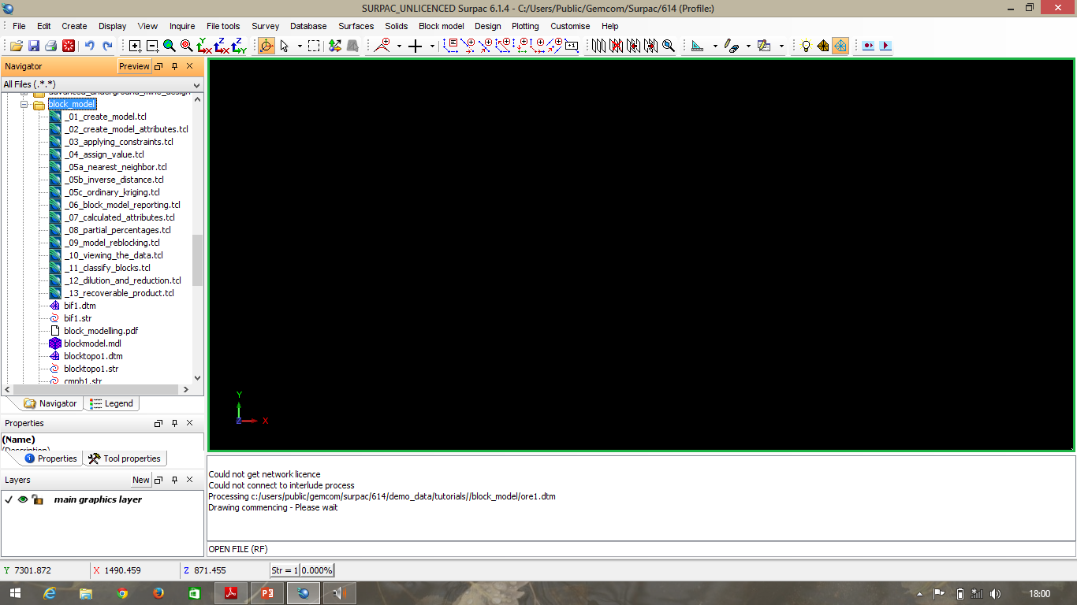

Slide 23
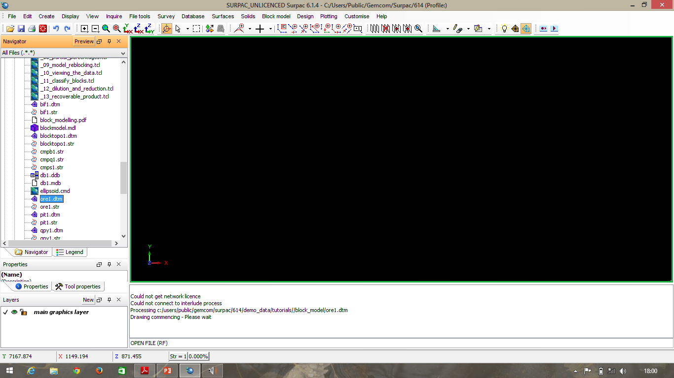
A file named “ore1.dtm” (in the navigator) under “block_model” folder is selected for creating a block model.

Slide 24
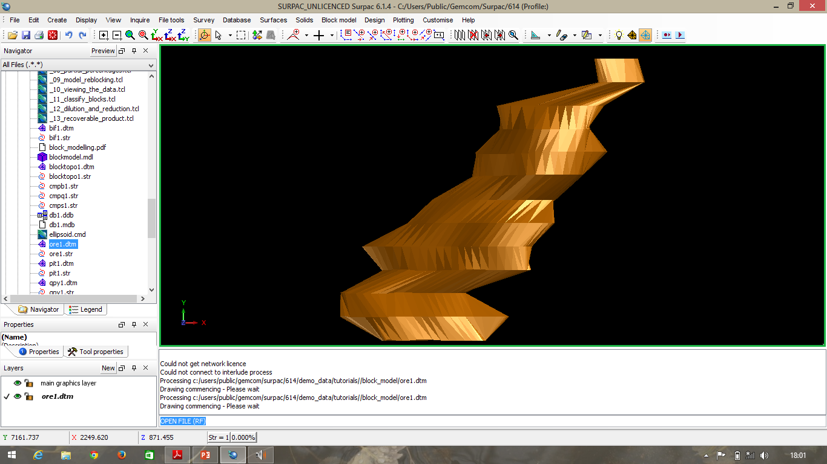

Slide 25
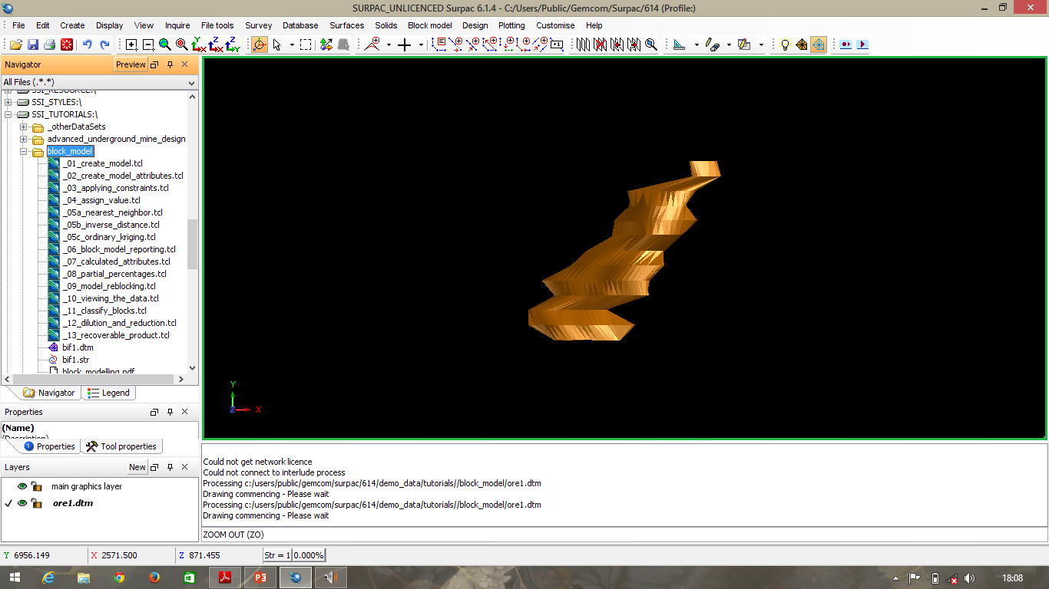
Choose View > Zoom out.

Slide 26
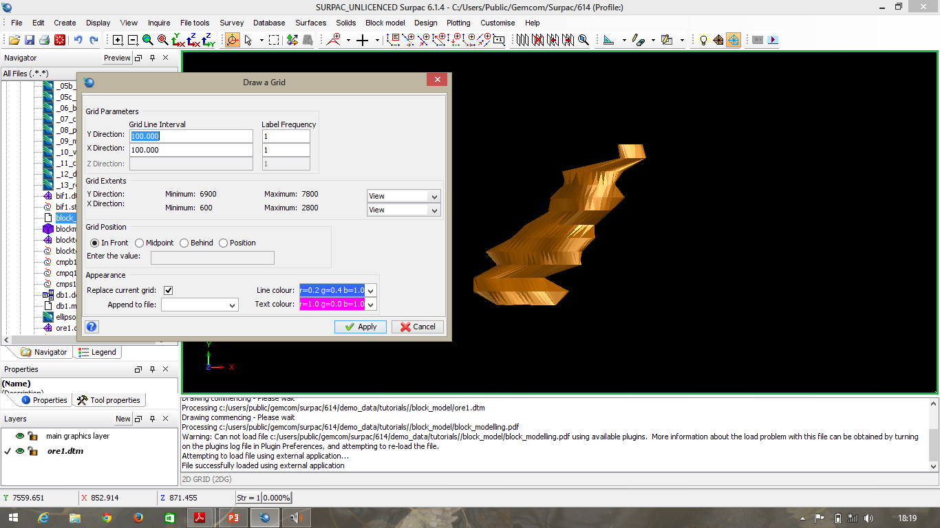
Choose Display > 2D grid. Enter the information as shown, and then click Apply

Slide 27
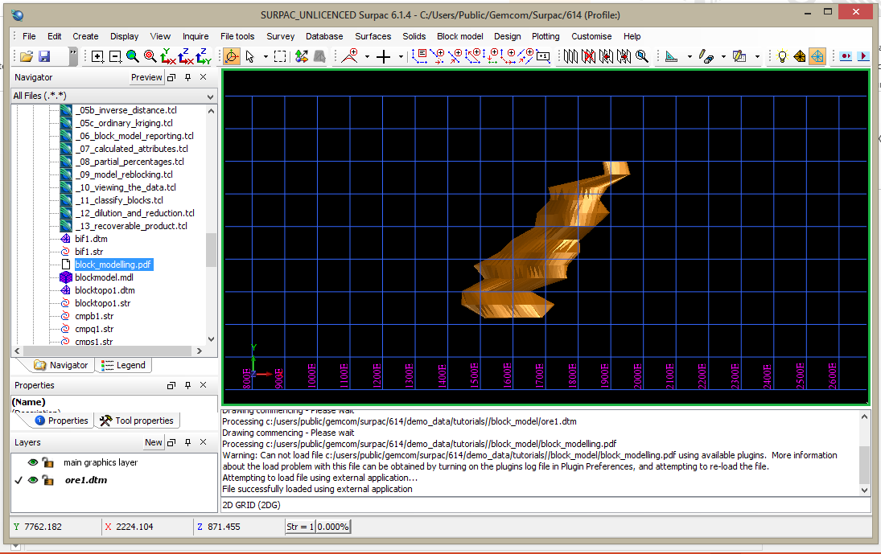
The orebody with the 2D in grid in plan view is displayed.

Slide 28
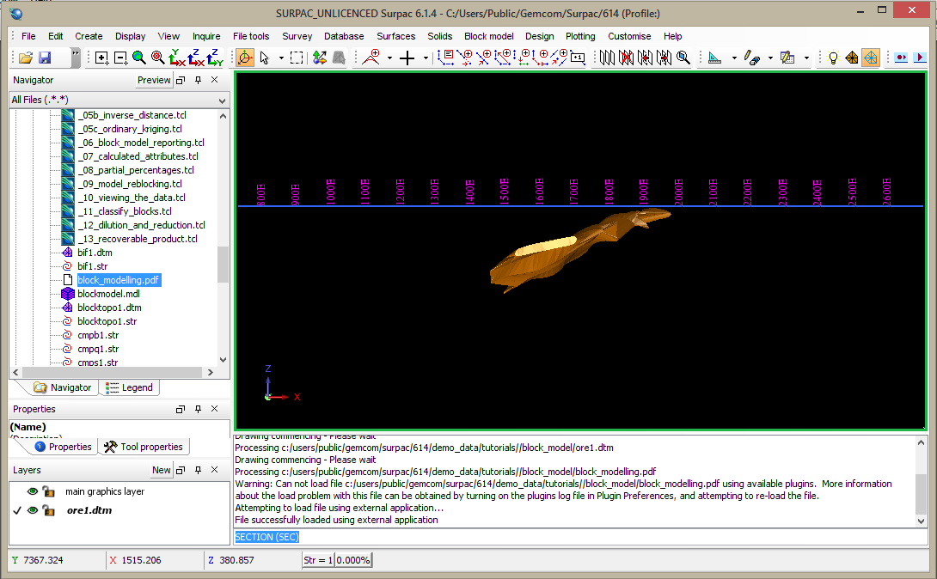

Slide 29
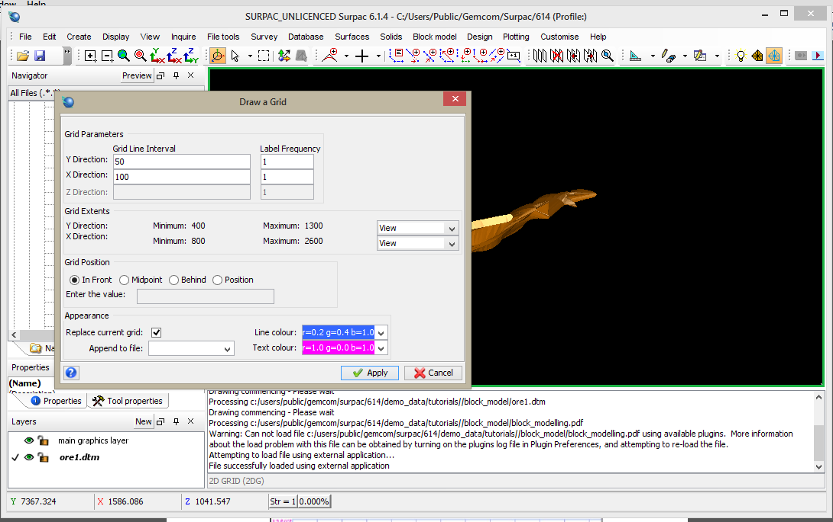
Choose Display > 2D grid. Enter the information as shown, and then click Apply.

Slide 30
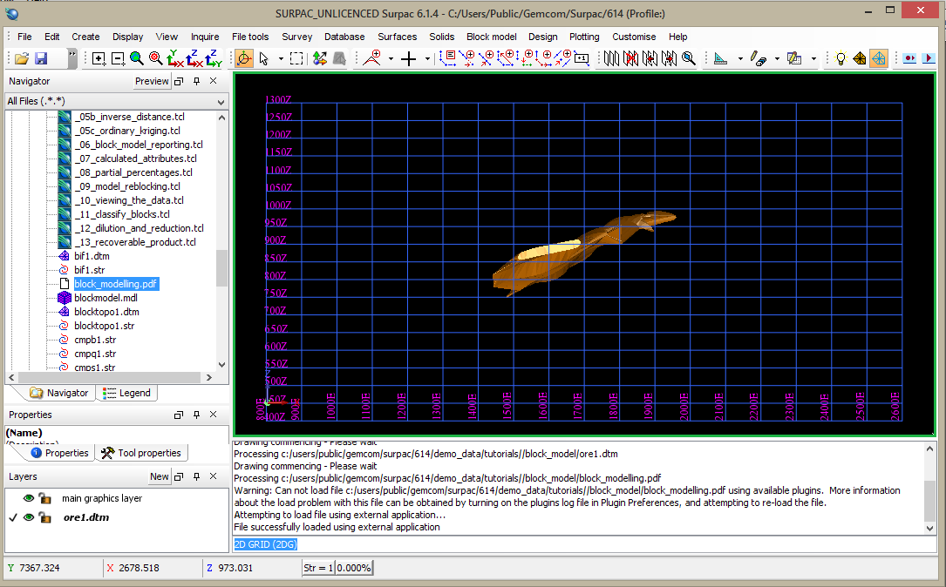

Slide 31
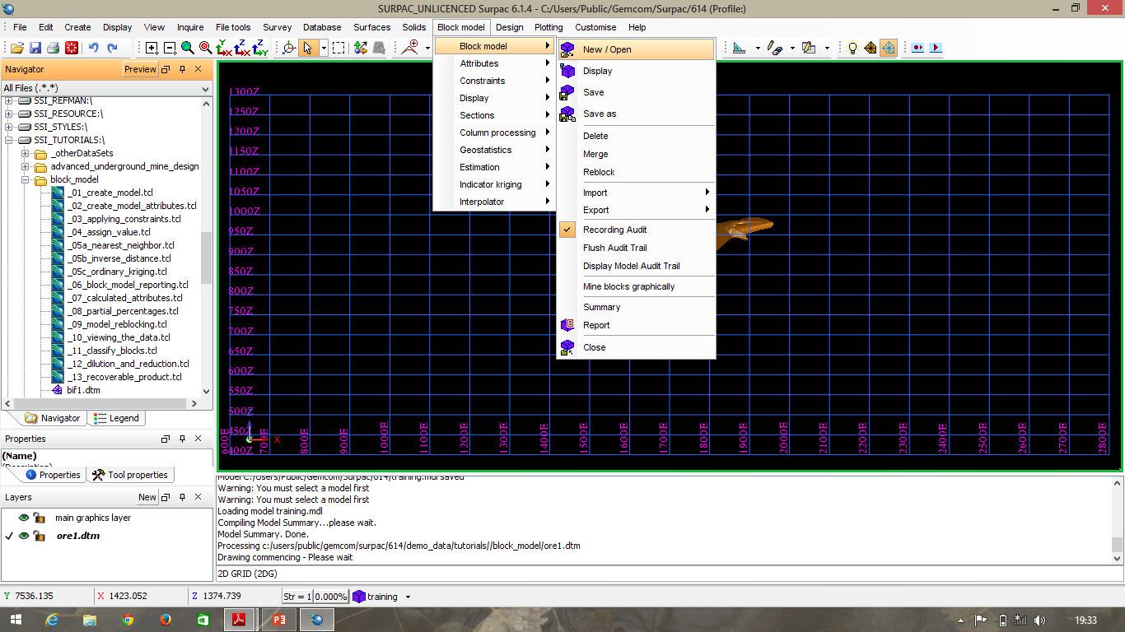
To determine the origin and extents directly from the data.
Choose Block model > New / Open.

Slide 32
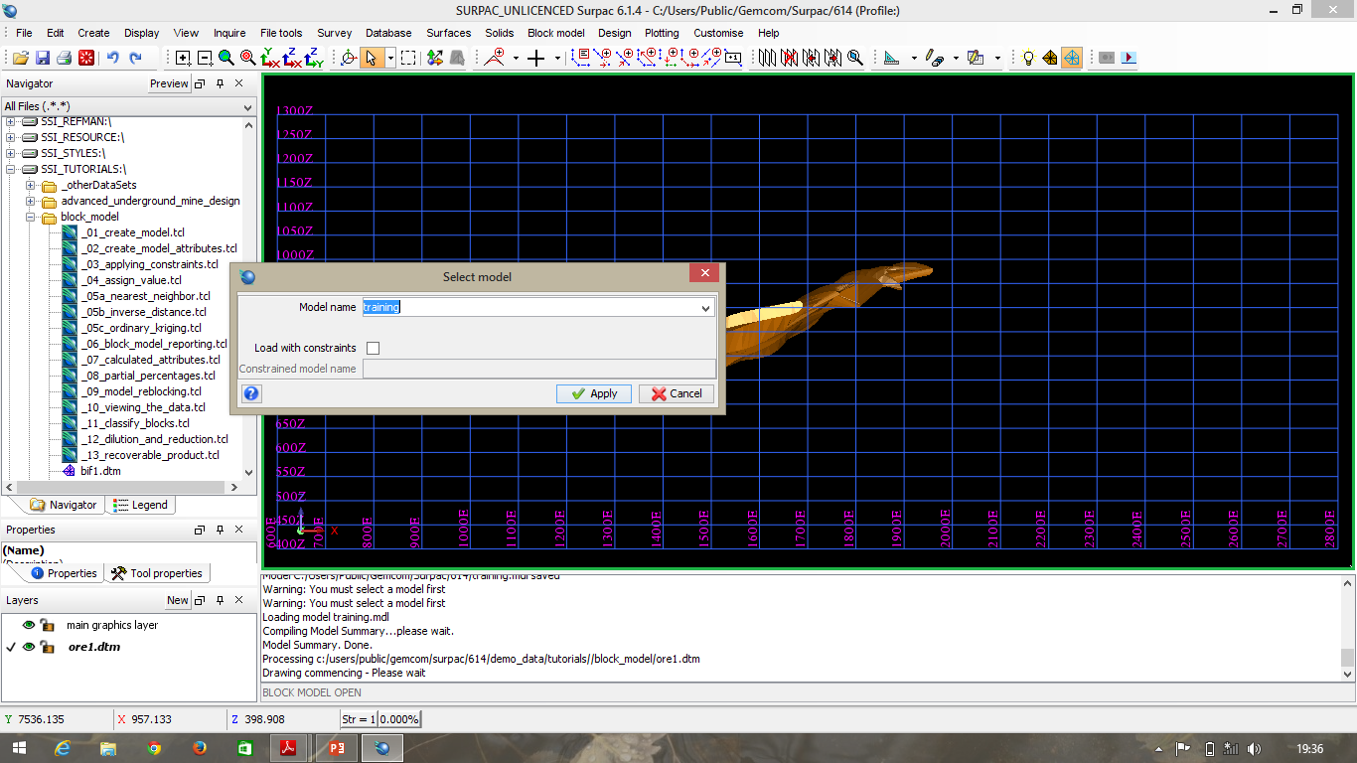
Enter the information as shown, and then click Apply.

Slide 33
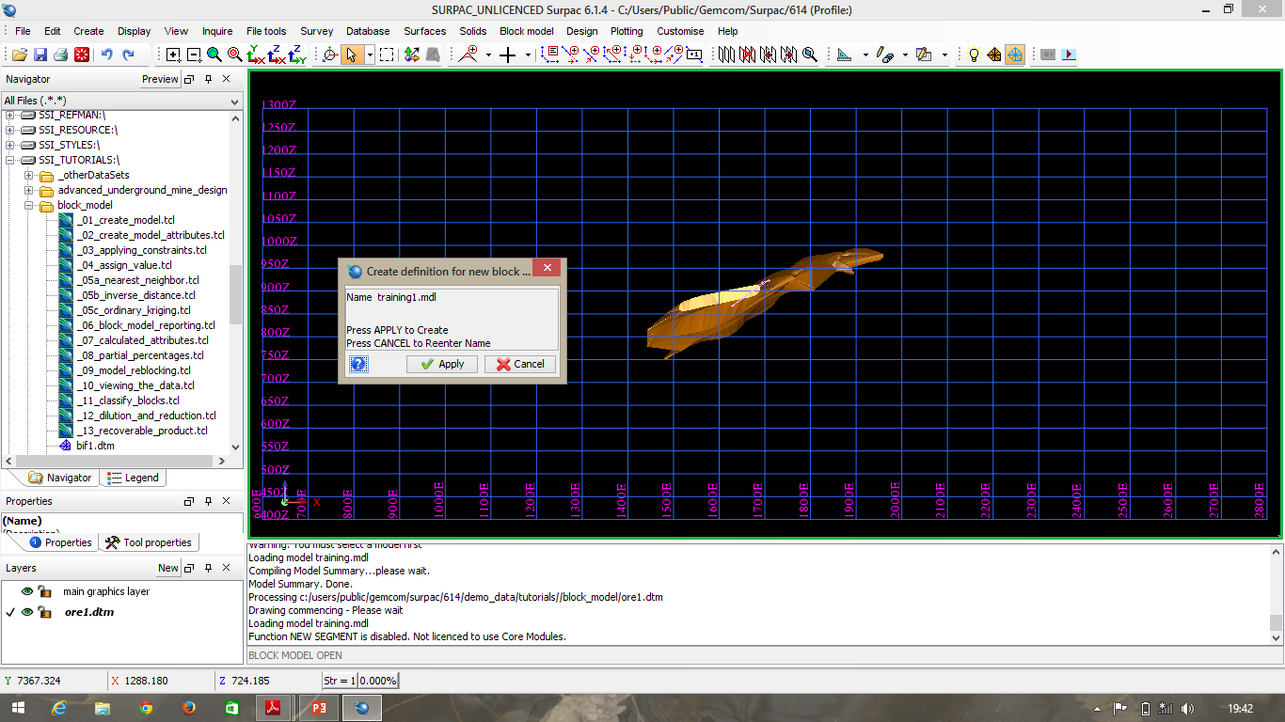
Click Apply to confirm creation of the new block model.

Slide 34
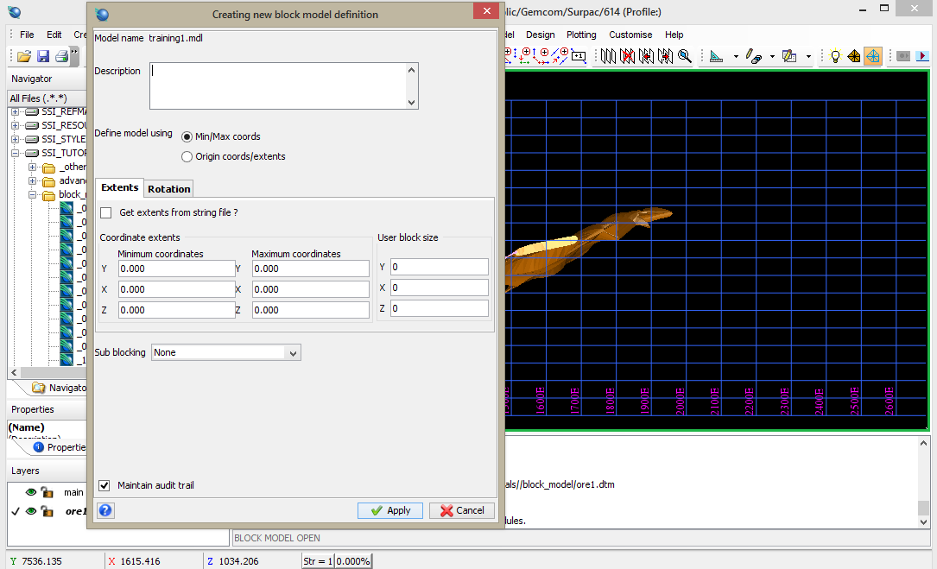

Slide 35
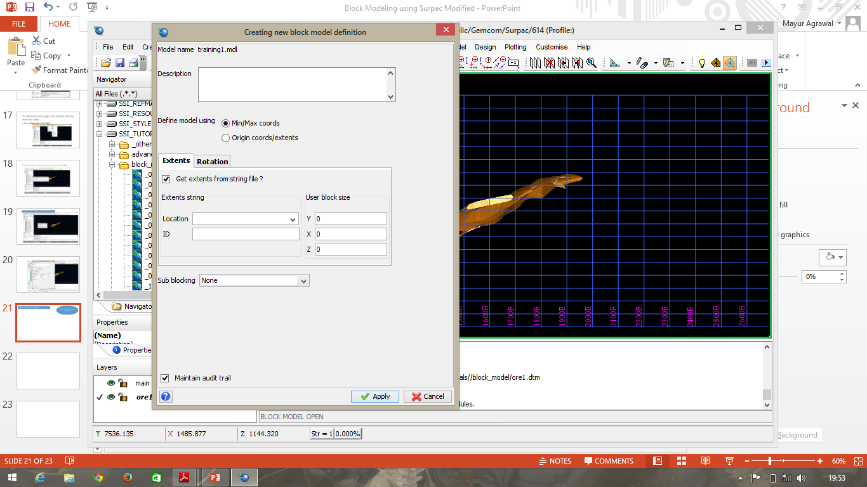
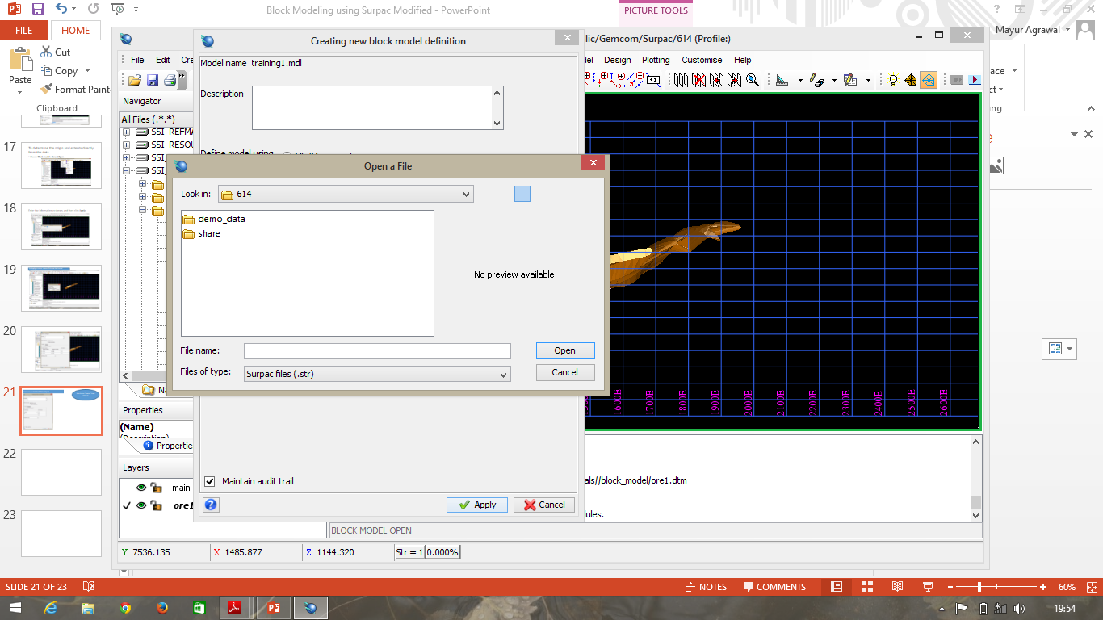
Then click on “Location” drop-down list to get “Open a file Dialog Box”

Slide 36
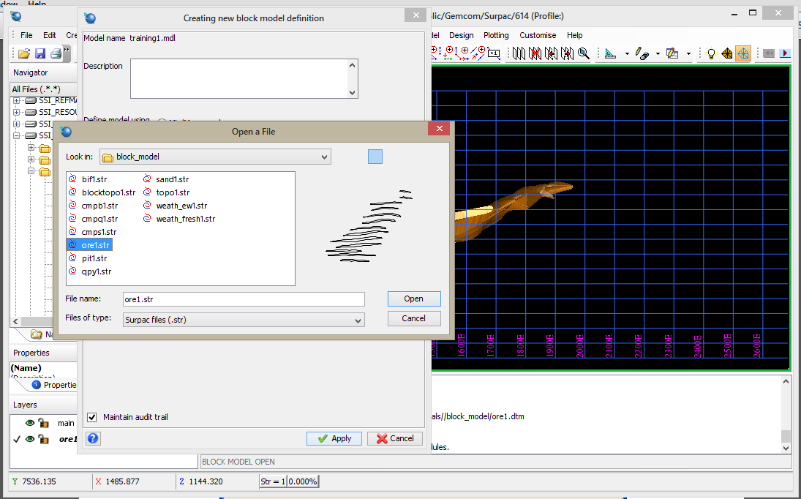
Choose ore1.strand click Open

Slide 37
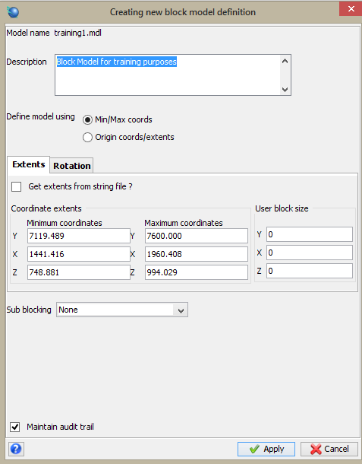
The models coordinates are filled in based on the values in ore1.str

Slide 38
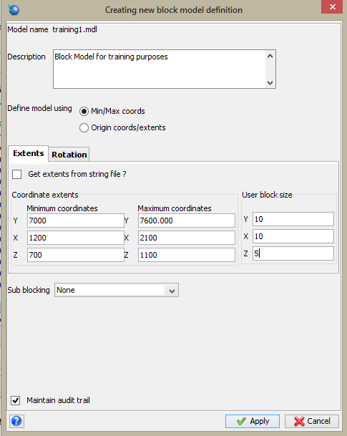
Adjust the values as shown to create a block model which fully covers the extents of the orebody.
Click Apply.

Slide 39
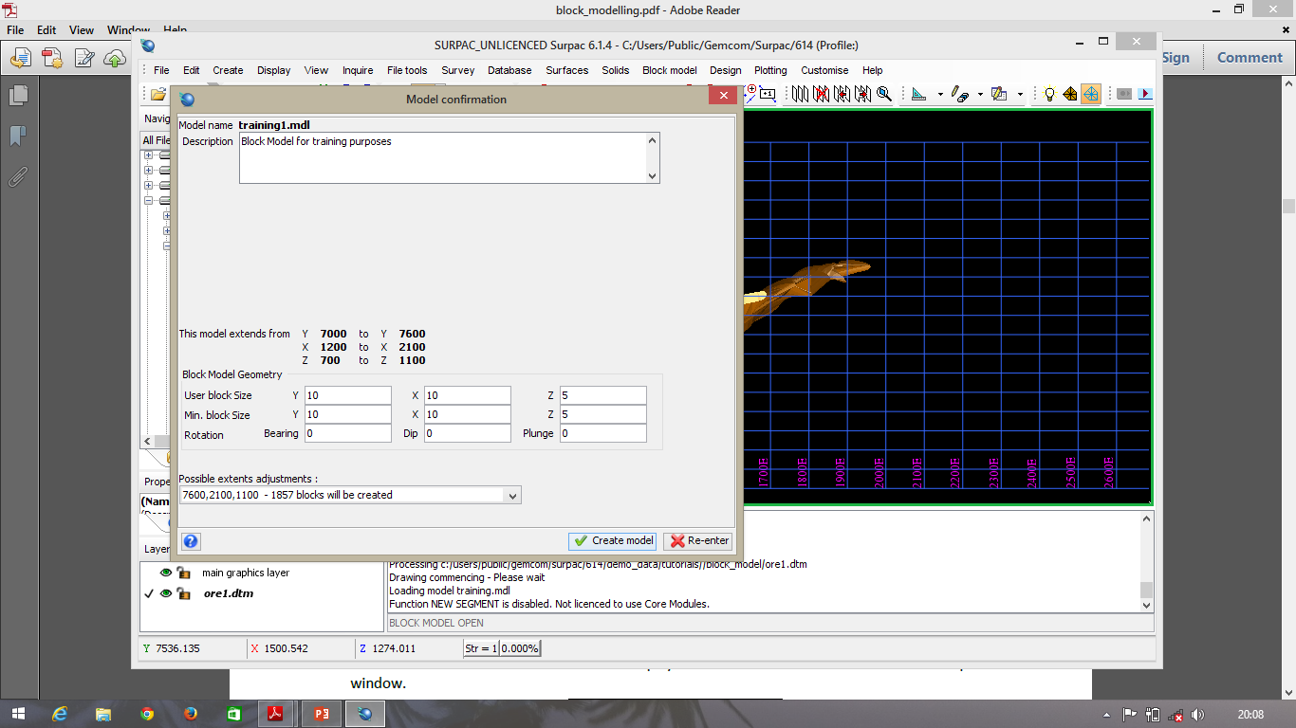
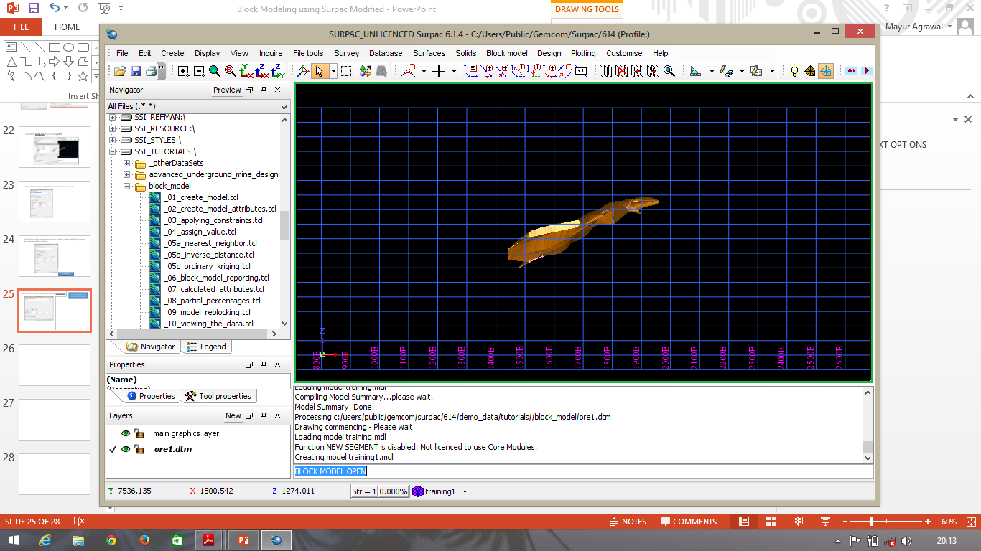
Enter the information as shown, and then click Create Model
The block model is created and its name is displayed in the status bar at the bottom of the Surpac window.

Slide 40
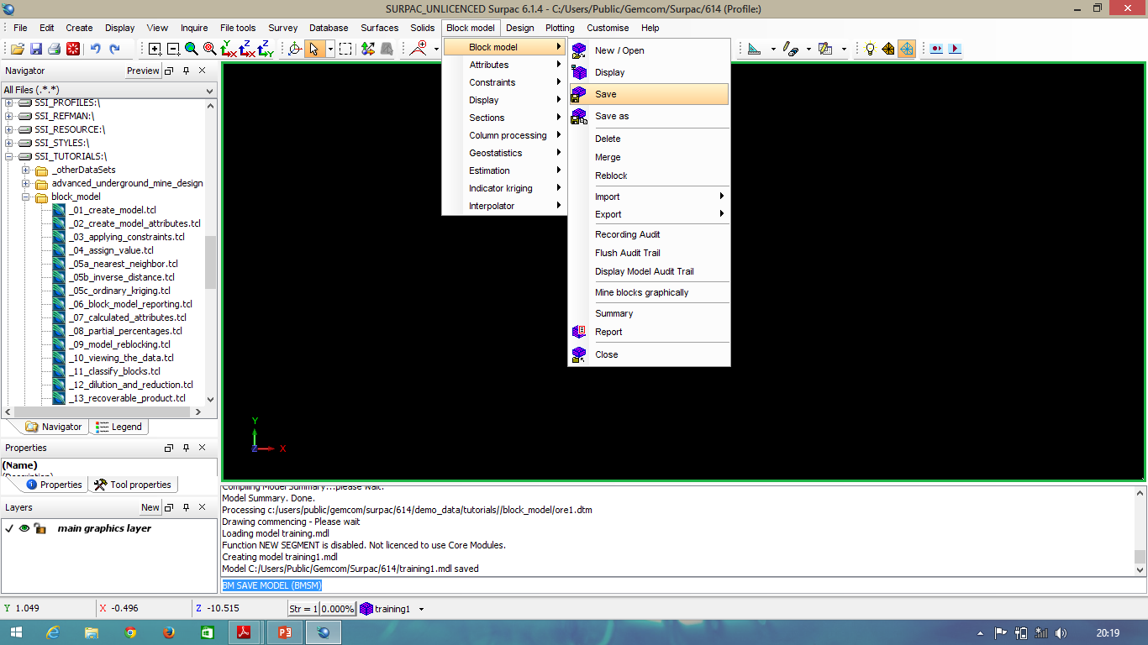
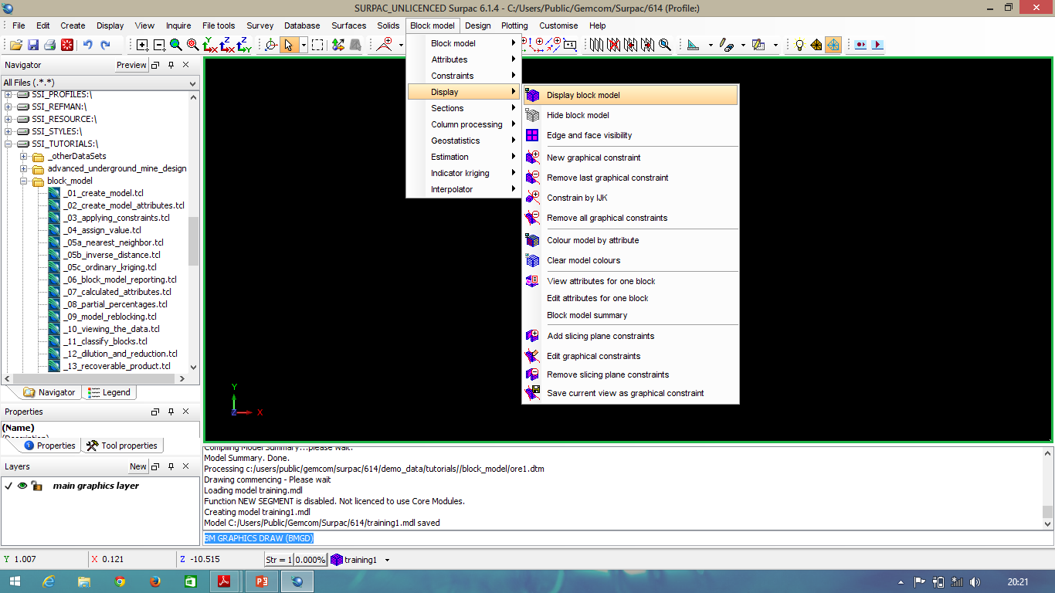
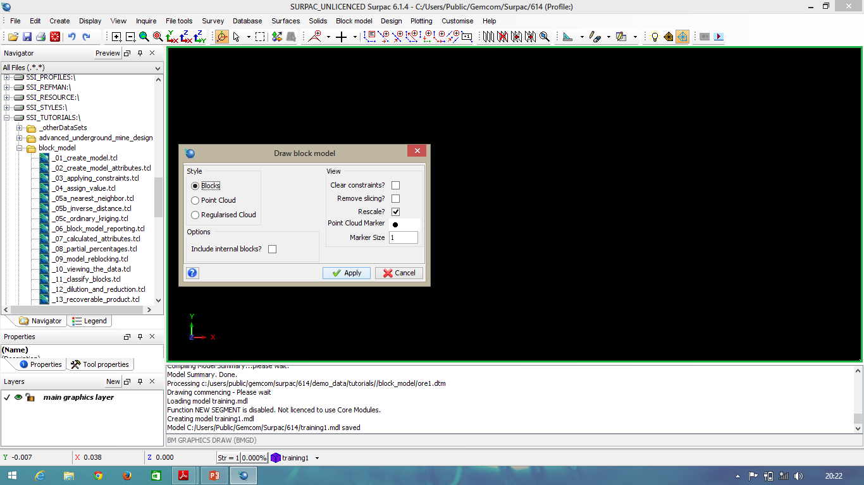

Slide 42
Thank you!

